Slide 1
How States Are Improving Tax Incentives for Jobs and Growth A national assessment of evaluation practices
Chaaron Pearson
cpearson@pewtrusts.org The Pew Charitable Trusts
11/16/2017

Slide 3
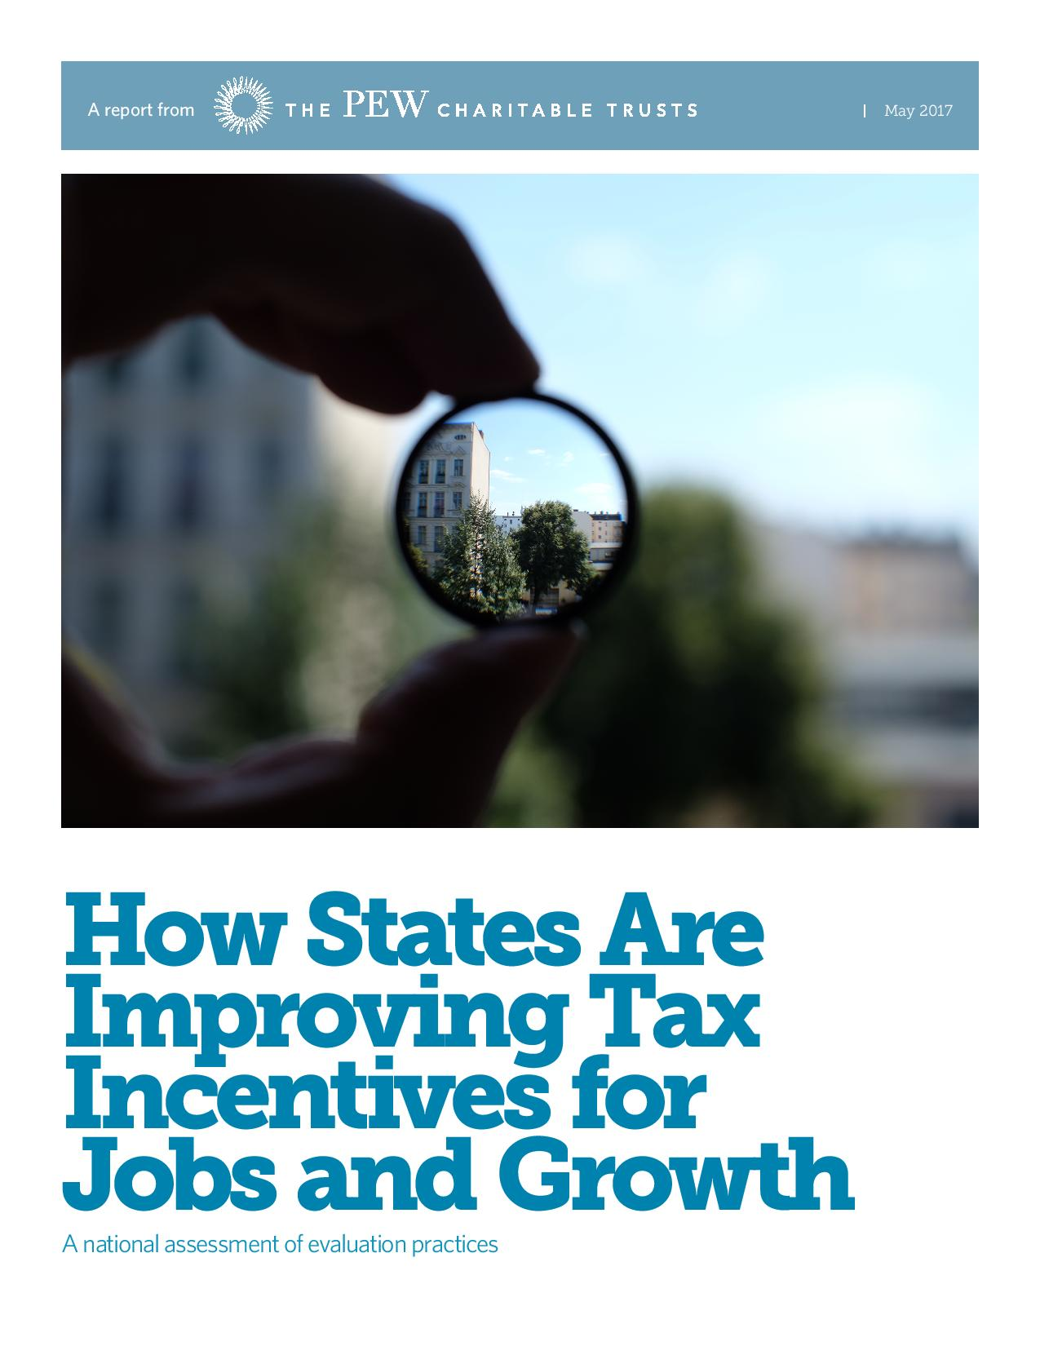

Slide 4
Why evaluate tax incentives
Tax incentives are one of states’ primary economic development tools
Tax incentives collectively cost states billions of dollars per year
Evaluation is a proven way to improve the effectiveness of incentives
Evaluations can lead to a more constructive conversation about incentives

Slide 5
Year evaluation laws were adopted in states that are “leading” or “making progress”
AK
WA
ME
ND
MN
OR
WI
IA
PA
HI
NE
IN
OH
NH
RI
CT
MD
DC
UT
CO
VA
MO
Pre-2014
2014
2015
2016
2017
TN
OK
MS
AL
TX
LA
FL

Slide 6
Three steps to effective evaluation
Step 1: Make a plan
Step 2: Measure the impact
Step 3: Inform policy choices

Slide 7
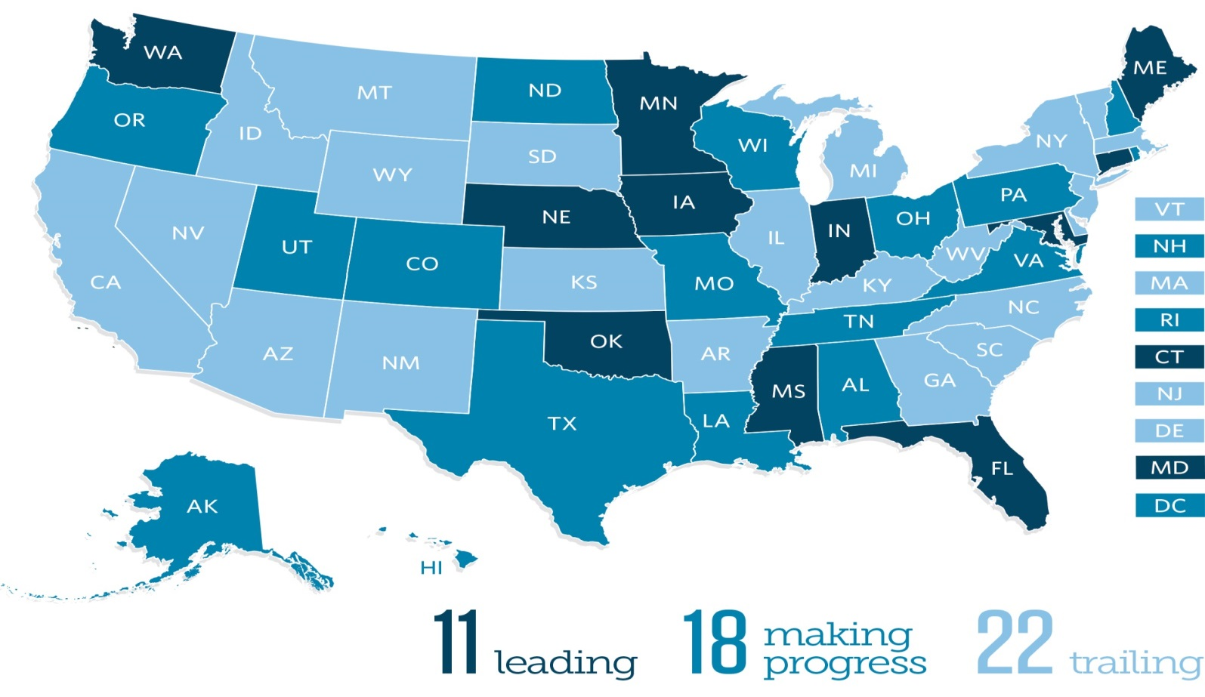
State tax incentive evaluation ratings

Slide 8
Make a plan: Who evaluates in states that are “leading” or “making progress”
AK
WA
ME
ND
MN
OR
WI
IA
PA
HI
NE
OH
NH
RI
CT
MD
DC
IN
UT
CO
VA
MO
TN
OK
MS
AL
Executive branch agency
TX
LA
Independent agency
FL
Legislative staff
Legislators themselves
Outside experts

Slide 9
Make a plan: Developing a strategic schedule
Include all major incentives
Use a rotating multi-year cycle
Study incentives with similar goals in the same year
Coordinate evaluations with sunset dates

Slide 10
Measure the impact: High-quality evaluations include…
A description of the incentive, its history, and goals
An assessment of the incentive’s design and administration
An estimate of the incentive’s economic and fiscal impact
Policy recommendations

Slide 11
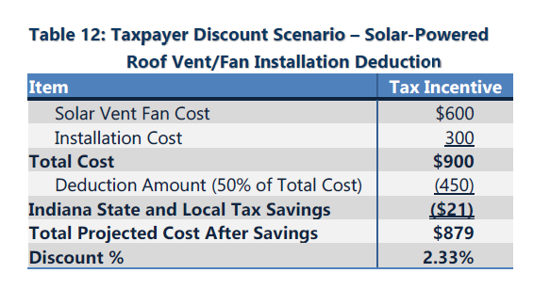
Evaluation example: Indiana

Slide 12
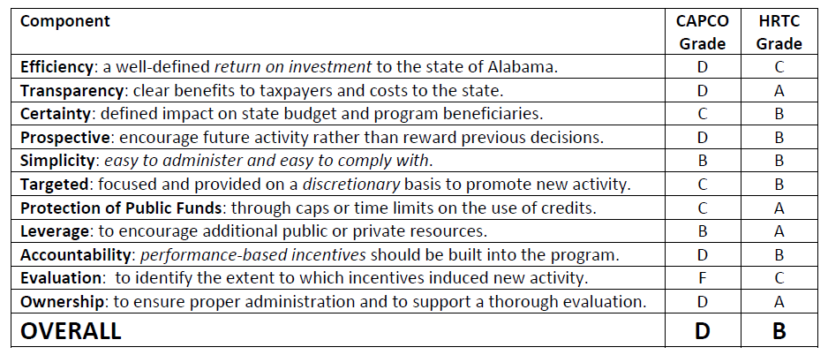
Evaluation example: Alabama

Slide 13
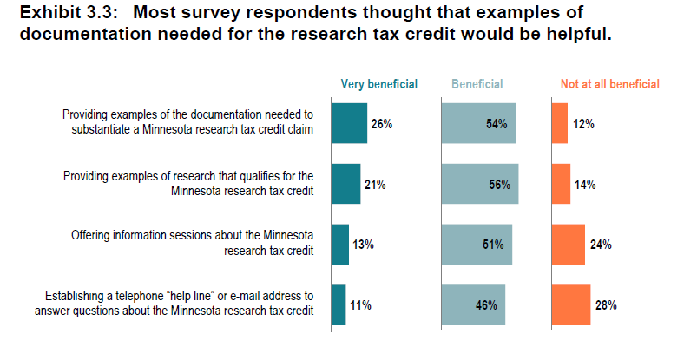
Evaluation example: Minnesota

Slide 14
Options to inform policy choices
Create new legislative committees
Utilize existing committee structure
Require the governor to make recommendations after evaluations
Establish expiration dates on incentives to encourage review

Slide 15
With evaluations, states can…
Make subtle changes to incentives to increase their return on investment
Identify programs that are working well, so that the state can invest in them with confidence
Repeal or replace ineffective or obsolete incentives

Slide 16
Chaaron Pearson Senior Manager, The Pew Charitable Trusts
cpearson@pewtrusts.org

